Slide 1
How Computers Work - Group 6 Practice Presentation
- Group 6 composed of Zidane Reid, Dmitrii Sizikov, Serhan Muslu, Maisha Begum and Mohamed Abdalla
As per the given criteria, our group plans to design and present a useable application that combines different concepts within and aspects of general computer science. For this purpose, we have devised an initial idea for said app and its basic functions.
We have visualised a social media/chatroom-style app named "Note" with a musical theme & focus. Ideally, users will have access to an in-built MP3/4 converter, supporting the APIs of other apps that boast music like YouTube and Spotify. Users will also have the option to socialise in public or private chatrooms and discuss music among any other topics with other users. They could also be given the option to share other information like profile info, song/video links and other related content via means innate to the app itself. From here, our ideas for the app's computerised design will be explained in further detail, entailing security, networking, connections and the like.
Our application will include many layers from file conversion to social interaction. It will have a messaging service, similarly to Discord, where users can send and receive music. Many chat rooms will be available and said chat rooms will run on the server side.

Slide 2

Abstraction
Abstraction is the process of filtering out and simplifying the characteristics of patterns and removing what we don’t need.
For example, if you were to take a house and make it an abstraction. You would simply draw the main characteristics of the house. Such as the door, windows, footway and normally it would be the front view of the house.
We can use this concept in computer science to simplify the most difficult pieces of software into digestible easy to understand segments.

Slide 3
User Communication
The main component of the application will be communication because our users will need to be able communicate reliably to share files and encryption will be needed to keep the data being shared secured.
There will be multiple ways to communicate from direct messaging to voice call. We will have chatrooms on the app where 1 user can share files with many other users. The number of users will depend on the size of the server.

Slide 4
The process of sending data
The user will send information through their own network using a packet which will have a source IP address and destination IP address. This will also include a source protocol and destination protocol (most likely on an ephemeral port for the client such as port 5000 and a destination port of 80 for the HTTP server)
The packet will travel within the users own internal network until it reaches the router then it will be sent out to the ISP which will send the data to the server. The server will then send the packet to the API on the application . The API will send the data to the message handler which will in turn encrypt the data and secure it.
One of three things will happen at this point depending on user input. The message will either be sent to a chatroom, or it will be a direct message depending on user needs. If the client wishes to make a voice call instead then the VOIP port will be used in conjunction with UDP.

Slide 5
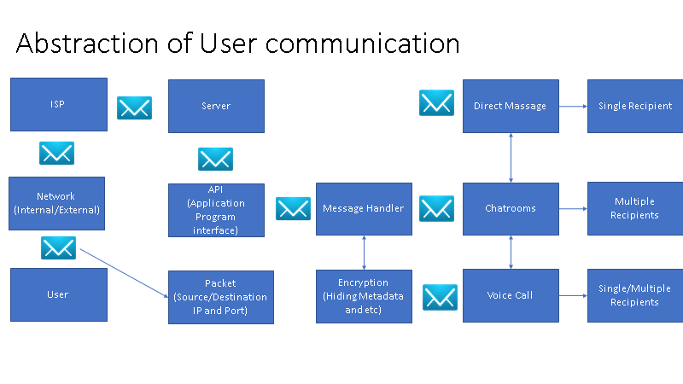

Slide 6
Bits & Bytes
A Bit is a single location of memory storage on a device – the smallest possible of its kind. Essentially, it is a binary language that understandable information like letters or numbers are translated into such that they can be stored on a machine like a computer. The language in question is represented through only the numbers 1 and 0, which is why it is called "binary" representation. These two numbers can be viewed as an on/off switch, or the answers "yes" and "no" to a given question. 1 returns a positive output, and 0 a negative.
More commonly known, though, is the Byte, a larger memory storage location made up of eight Bits. The Byte is the basis for the Kilo-, Mega-, Giga- and Terabyte, the most well-known forms of memory storage for most machine users. Bytes are certainly more useable than Bits in terms of practicality, but most modern machines will use around eight Bytes – that is, 64 Bits – to store single sets of information like words, sentences, instructions, larger numbers and the like.

Slide 7
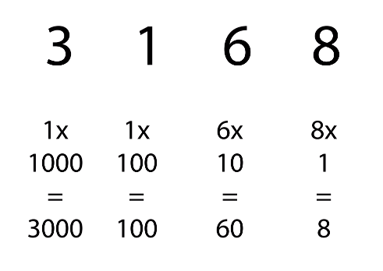
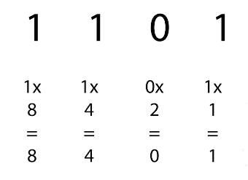
Bits & Bytes - Further Explanation
As written previously, Bit coding is done in binary format, which is the same principle as our common denary system, just using powers of 2 instead of 10.
For example, as seen here, a regular number like 3168 is comprised of four value columns, decreasing by powers of 10 from the beginning to the end of the word.
On the other hand, Binary notation uses a similar format, but values decrease by powers of 2 rather than 10. Attached is an example, where 1 implies the existence of a value and 0 implies its absence.
Our App will be using Unicode instead of the ASCII
System since we want people from different countries to be able to access the site. Uni code uses between 8 to 32 bits per character so it's more extensive than ASCII, including more languages for our app.
Example of Denary formatting
Example of Binary formatting

Slide 8

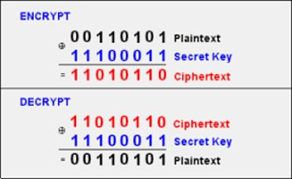
Encrypting our App:
Encryption: Is the process of converting information or data into what looks like a random set of characters to prevent unauthorized access
Since our App is going to act like a social media platform, we are going to need a strong form of encryption to stop anyone from having access to user communication.

Slide 9
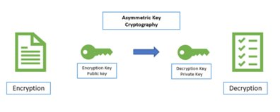
The way it would work:
To do this we are going to use a form of encryption called "Asymmetric encryption".
The way it works is every user would have a public key which would be used to encrypt the messages being sent, then once the message is received at the other end a private key can be used to decrypt it.
This form of encryption involves 2 types of keys a (public key and a private key)

Slide 10



Storage:
Different ways to store data:
Storing data on a personal device:
ADV: Costs less and new users can be easily added to the network
DIS: less secure and it is difficult to carry out updates
Our App:
The client's personal music/videos would be stored on a remote server, so it is easy for them to access it, play it or download it.
Also, the user’s login details would be stored on the same remote server as well as all client messages (the server would have all security measures in place such as encryption).
Storing data in a Cloud:
ADV: Cheaper than storing data on a server and easy to carry out updates
DIS: security depends on the company which hosts the cloud and limited storage space
Storing data on a personalised Server:
ADV: Large storage capacity and data can be managed centrally
DIS: Expensive

Slide 11
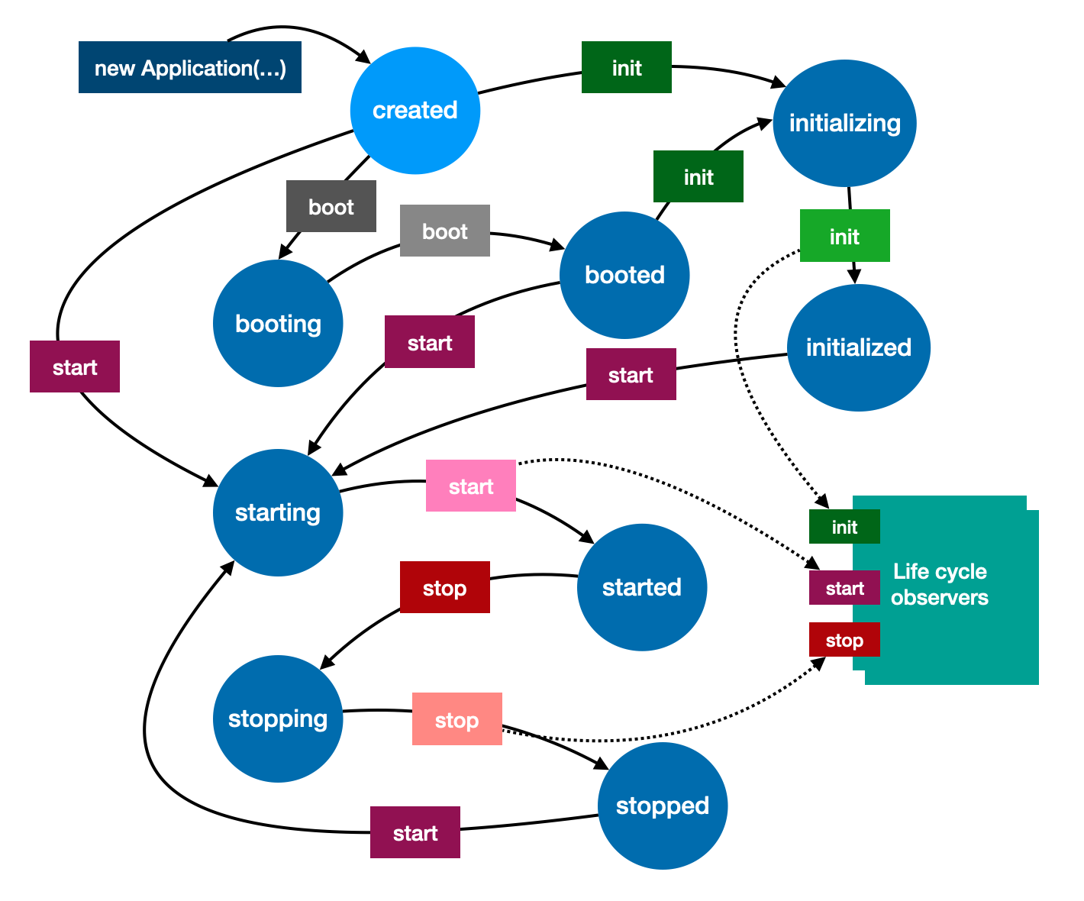
What is a State?
States represent the totality of everything necessary to keep your application running. The application states contain all the contents of the memory. An application's state can include all the application's variables and static variables to it. Besides that, we can talk about things like kernel buffers or registers.
In short sentences, everything the user does in the Note application goes through different states. For example, when the user starts to download a file or music, the Note application enters the download state.

Slide 12
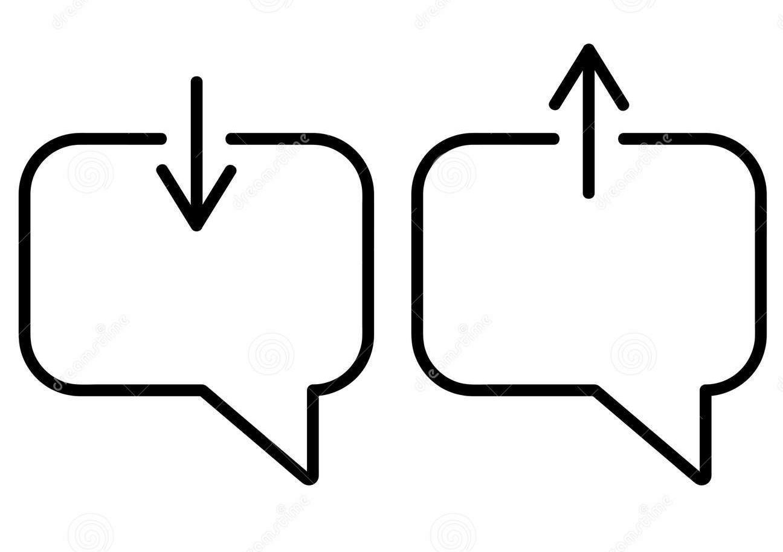


In our "Note" app, an activity is considered “online” means that the user is using the Note app. In this case, the user can send and receive messages from other users, download and listen to music.
The "offline" state is the state that indicates that a user is currently not using the Note. In offline state, the user will not be able to receive and forward messages from another user in any way.
If the Note is in the "uploading" state, it indicates that the user has uploaded images or files to the Note.
If Note is in the "download" state, it means that the user has downloaded pictures, music or files from the Note.
States of our app

Slide 13
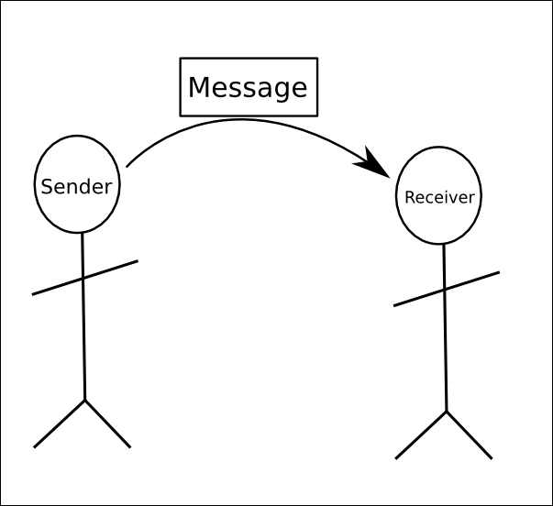


The "message sent" status means you have sent a file, image or text or chat to someone, and the Note acknowledges it.
The "message received" means the file, image or text has been delivered to the recipient.
The "message delivered" means the "Note" app has verified the delivery of the file, image or text to the recipient.
"Sending" status is the state in which the user forwards his message to the other user.
States of our app

Slide 14
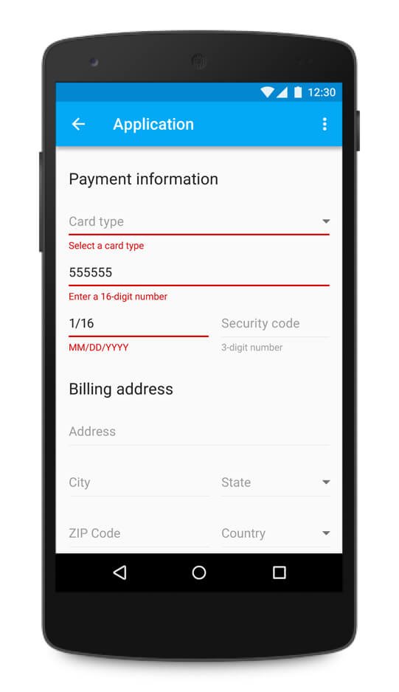
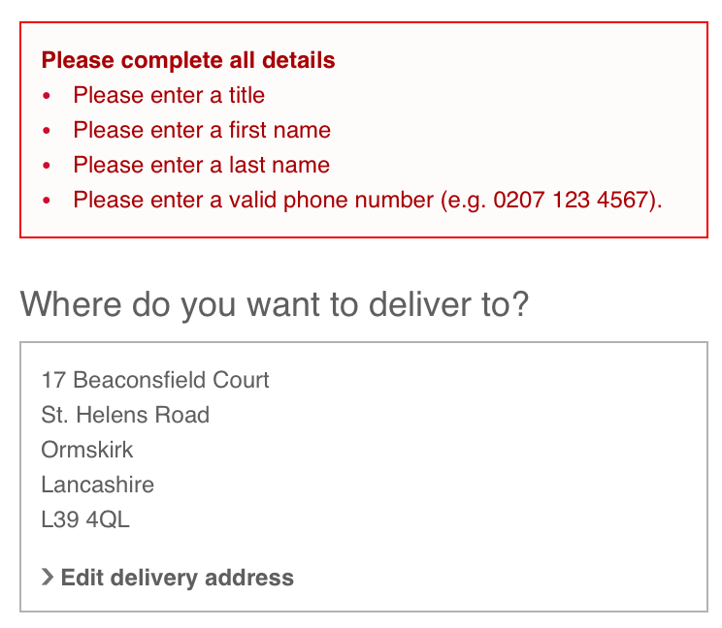
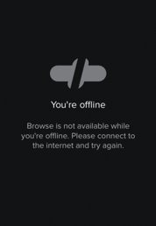
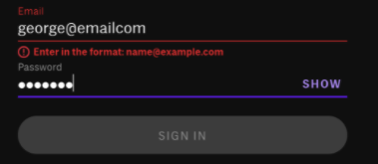
Error States
The error screen is the screen that shows that something went wrong with the application. Error screens contain information showing what went wrong. In this way, the user understands that the problem is with either the application or an input entered by user. What kind of problems might users face in Note?
It is a problem that users may encounter when try to upload large files to the "Note".
When there is a problem with the Internet connection, the user cannot use all the features in the application(browse for music or send messages)
When there is a maintenance on the "Note" server or if there is a server outage, no user can access the application.
If the application cannot get the required information, it may give a warning message. Such as, when the user enters invalid e-mail or password.
If the internet is cut off while sending a message, the receiver cannot receive the sent message.

